Slide 1
INTRODUCTION TO COMPUTING
Course Code: CCINCOM/L
Graphs
Joseph Marvin R. Imperial
Faculty
Department of Computer Science
College of Computing and Information Technologies (CCIT)
National University
Joseph Marvin R. Imperial
ALGORITHMS AND COMPLEXITY
NU College of Computing and Information Technologies
Course Code: ALGOCOM

Slide 2
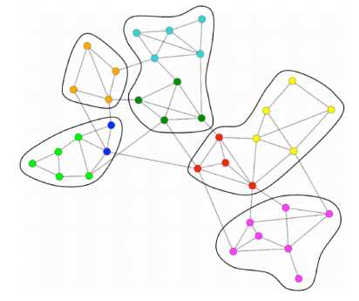
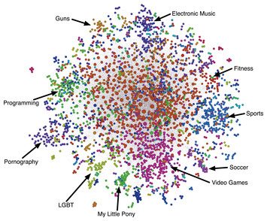
Graphs as a data structure
Graphs are a powerful and versatile data structure that easily allow you to represent relationships between different types of data (nodes).
ALGORITHMS AND COMPLEXITY
Course Code: ALGOCOM

Slide 3
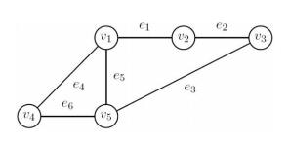
Graphs as a data structure
A graph G = (V, E) is a pair of vertices (or nodes) V and a set of edges E, assumed finite i.e. |V| = n and |E| = m
Here V(G) = {v₁, v₂, . . . , v₅} and E(G) = {e₁, e₂, . . . , e₆}
An edge e_{k} = (v_{i}, v_{j}) is incident with the vertices v_{i} and v_{j}
ALGORITHMS AND COMPLEXITY
Course Code: ALGOCOM

Slide 4
Components of a graph
There are two main parts of a graph:
The vertices (nodes) where the data is stored i.e. the numbers in the image on the left
The edges (connections) which connect the nodes i.e. the lines between the numbers in the image
ALGORITHMS AND COMPLEXITY
Course Code: ALGOCOM

Slide 5
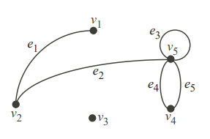
Consider this graph
We have V = {v₁, . . . , v₅} for the vertices and E = {(v₁, v₂), (v₂, v₅), (v₅, v₅), (v₅, v₄), (v₅, v₄)} for the edges or E = {e₁, . . . , e₅}.
Note: Two edges like (v₁, v₂) and (v₂, v₁) are the same. In other words, the pair is not ordered in this case.
ALGORITHMS AND COMPLEXITY
Course Code: ALGOCOM

Slide 6
Terminologies
The two vertices v₁ and v₂ are end vertices of the edge (v₁, v₂) or e₁.
Edges that have the same end vertices are parallel.
An edge of the form (v, v) is a loop.
A graph is simple if it has no parallel edges or loops.
A graph with no edges (i.e. E is empty) is empty.
A graph with no vertices (i.e. V and E are empty) is a null graph.
A graph with only one vertex is trivial.
Edges are adjacent if they share a common end vertex.
ALGORITHMS AND COMPLEXITY
Course Code: ALGOCOM

Slide 7
Terminologies
The degree of the vertex v, written as d(v), is the number of edges with v as an end vertex. By convention, we count a loop twice and parallel edges contribute separately.
An isolated vertex is a vertex whose degree is 0.
A path can be defined as the sequence of nodes that are followed in order to reach some terminal node v from the initial node u.
ALGORITHMS AND COMPLEXITY
Course Code: ALGOCOM

Slide 8
Activity
v₄ and v₅ are end vertices of ____________________.
e₄ and e₅ are __________.
e₃ is a __________.
Is the graph simple?
e₁ and e₂ are ___________.
v₁ and v₂ are ___________.
The degree of v₅ is __________.
The degree of v₄ is __________.
The degree of v₃ is 0 so it is an _________ vertex.
What are the possible paths from v₁ to v₄?
ALGORITHMS AND COMPLEXITY
Course Code: ALGOCOM
Notes:
E5
Parallel
Loop
No
Adjacent
Adjacent
5
2
isolated

Slide 9
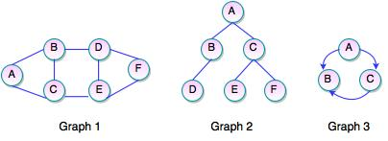
Activity
Write down the edges and vertices of each graph in set representation.
ALGORITHMS AND COMPLEXITY
Course Code: ALGOCOM
Notes:
E5
Parallel
Loop
No
Adjacent
Adjacent
5
2
isolated

Slide 10
Types of a graph
There are several main types of graphs:
Undirected graphs
Directed graphs
Complete graphs
Bipartite graphs
Weighted graphs
Cyclic and acyclic graphs
ALGORITHMS AND COMPLEXITY
Course Code: ALGOCOM

Slide 11
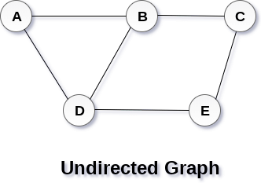
Undirected graph
In an undirected graph, edges are not associated with the directions with them.
If an edge exists between vertex A and B then the vertices can be traversed from B to A as well as A to B.
ALGORITHMS AND COMPLEXITY
Course Code: ALGOCOM

Slide 12
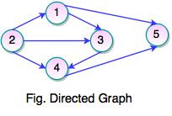
Directed graph (digraphs)
In a directed graph, edges form an ordered pair. Edges represent a specific path from some vertex v₁ to another vertex v₂.
Node v₁ is called initial node while node v₂ is called terminal node.
If an edge is represented using a pair of vertices (v₁, v₂), the edge is said to be directed from v₁ to v₂.
ALGORITHMS AND COMPLEXITY
Course Code: ALGOCOM

Slide 13
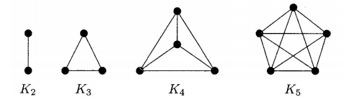
Complete graph
A complete graph is the one in which every node is connected with all other nodes.
A complete graph contain n(n-1)/2 edges where n is the number of nodes in the graph.
ALGORITHMS AND COMPLEXITY
Course Code: ALGOCOM

Slide 14
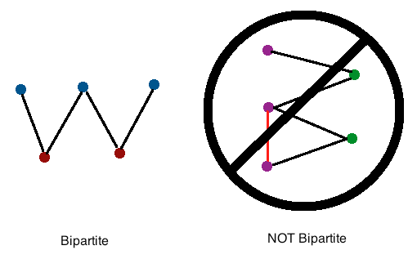
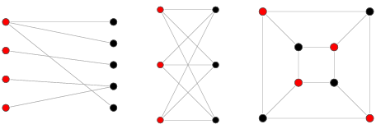
Bipartite graph (bigraphs)
A graph where vertices are disjointed into two subsets (V₁ and V₂), such that each edge connects a vertex from one set to a vertex from another subset.
Note, that no vertices both in V₁ or both in V₂ are connected.
V(G) = V₁ ∪ V₂ and V₁ ∩ V₂ =∅.
ALGORITHMS AND COMPLEXITY
Course Code: ALGOCOM

Slide 15
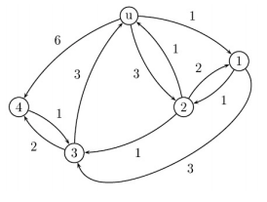
Weighted graph
In a weighted graph, each edge is assigned with some value such as length or weight. The weight of an edge e must be a positive (+) value indicating the cost of traversing the edge.
ALGORITHMS AND COMPLEXITY
Course Code: ALGOCOM

Slide 16
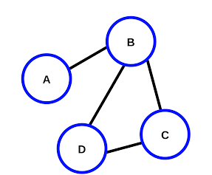
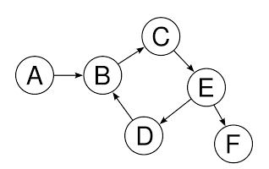
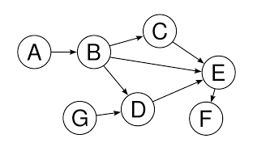
Cyclic and acyclic graphs
A cyclic graph is a directed graph which contains a path from at least one node back to itself. In simple terms cyclic graphs contain a cycle.
An acyclic graph is a directed graph which contains absolutely no cycle, that is no node can be traversed back to itself.
ALGORITHMS AND COMPLEXITY
Course Code: ALGOCOM

Slide 17
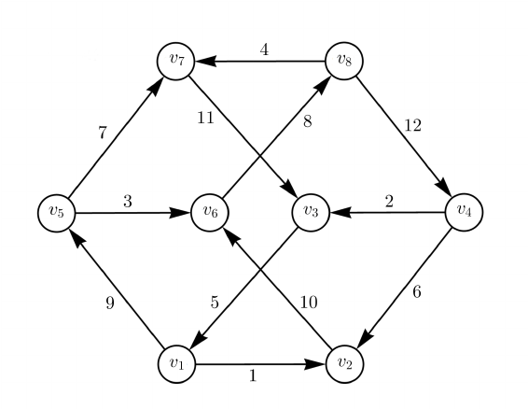
Give the characteristics of this graph
Directed or undirected?
Simple or not?
Bipartite or not?
Weighted or unweighted?
Cyclic or acyclic?
Null or not?
What are the vertices?
What are the edges?
What’s the cardinality of the set containing all the vertices?
ALGORITHMS AND COMPLEXITY
Course Code: ALGOCOM

Slide 18
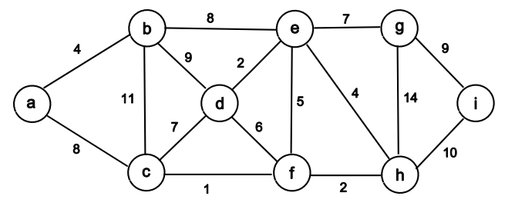
Give the characteristics of this graph
Directed or undirected?
Simple or not?
Bipartite or not?
Weighted or unweighted?
Cyclic or acyclic?
Null or not?
What are the vertices?
What are the edges?
What’s the cardinality of the set containing all the vertices?
ALGORITHMS AND COMPLEXITY
Course Code: ALGOCOM

Slide 19
Applications of graphs and graph theory
Social media and network analysis
GIS and mapping
Data mining
Web design and development
Hard sciences (physics, chemistry, and biology)
Language studies
Search engine optimization
Flight reservations
Electronic circuits
…
ALGORITHMS AND COMPLEXITY
Course Code: ALGOCOM

Slide 20
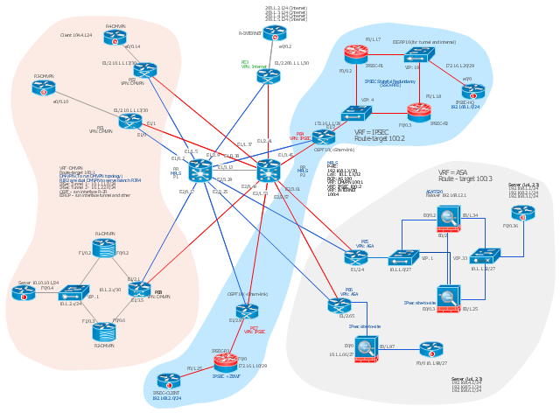
Network architecture and operations
https://neo4j.com/business-edge/managing-network-operations-with-graphs/
ALGORITHMS AND COMPLEXITY
Course Code: ALGOCOM

Slide 21
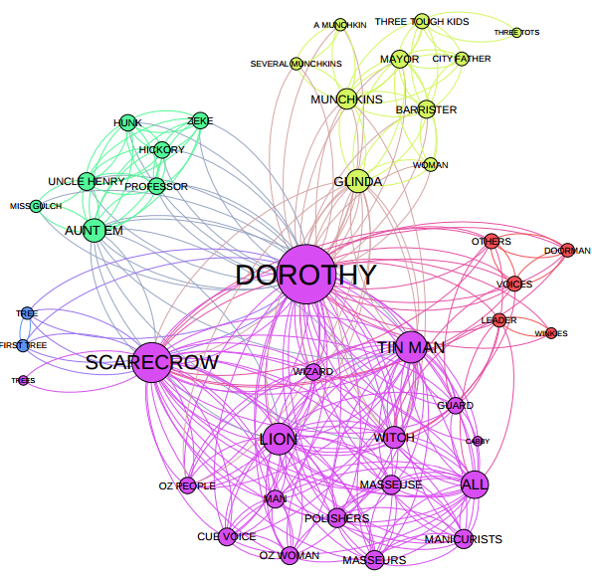
Character interaction in a story or series of events
https://mapr.com/blog/driving-insights-network-graphs//
ALGORITHMS AND COMPLEXITY
Course Code: ALGOCOM

Slide 22
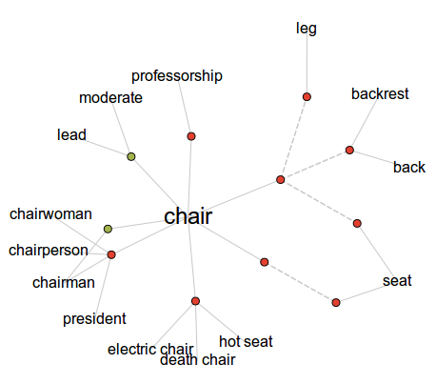
Word nets
https://mapr.com/blog/driving-insights-network-graphs//
ALGORITHMS AND COMPLEXITY
Course Code: ALGOCOM

Slide 23
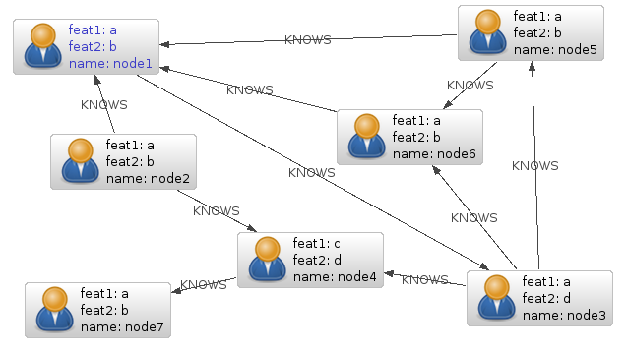
Relationships of database entities
https://neo4j.com/blog/social-networks-in-the-database-using-a-graph-database/
ALGORITHMS AND COMPLEXITY
Course Code: ALGOCOM

Slide 24
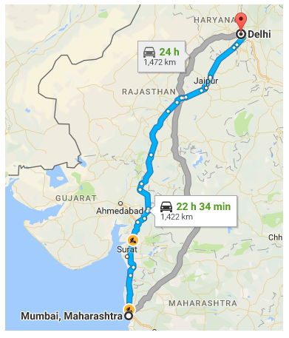
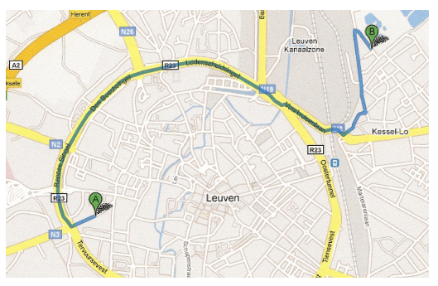
Navigation systems
https://neo4j.com/blog/social-networks-in-the-database-using-a-graph-database/
ALGORITHMS AND COMPLEXITY
Course Code: ALGOCOM

Slide 25
Representing graphs
Adjacency list
Adjacency matrix
ALGORITHMS AND COMPLEXITY
Course Code: ALGOCOM

Slide 26
Adjacency Matrix
For a graph with |V| vertices, an adjacency matrix of |V| x |V| is a matrix of 0s and 1s, where the entry in row i and column j is 1 if and only if the edge is in the graph.
If you want to indicate an edge weight, put it in the row i, column j entry, and reserve a special value (perhaps null) to indicate an absent edge.
ALGORITHMS AND COMPLEXITY
Course Code: ALGOCOM

Slide 27
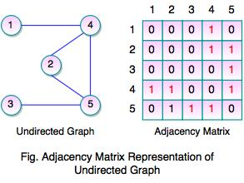
Adjacency matrix (undirected graph)
ALGORITHMS AND COMPLEXITY
Course Code: ALGOCOM

Slide 28
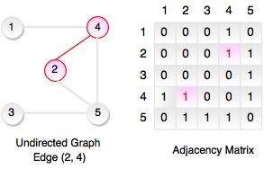
Adjacency matrix (undirected graph)
It shows adjacency matrix of undirected graph is symmetric.
If there is an edge (2, 4), there is also an edge (4, 2).
ALGORITHMS AND COMPLEXITY
Course Code: ALGOCOM

Slide 29
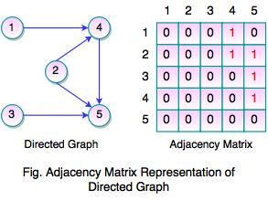
Adjacency matrix (directed graph)
If there is an edge (2, 4), there is also an edge (4, 2).
For a directed graph, the adjacency matrix need not be symmetric.
ALGORITHMS AND COMPLEXITY
Course Code: ALGOCOM

Slide 30
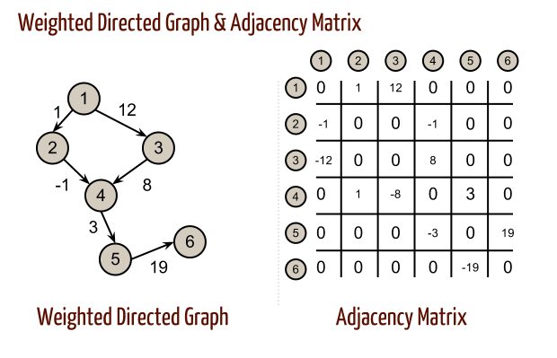
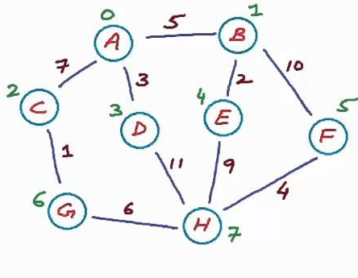
Get the adjacency matrix
ALGORITHMS AND COMPLEXITY
Course Code: ALGOCOM

Slide 31
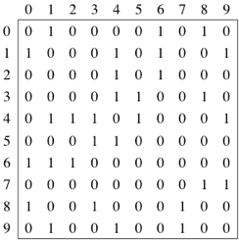
Get the graph
ALGORITHMS AND COMPLEXITY
Course Code: ALGOCOM

Slide 32
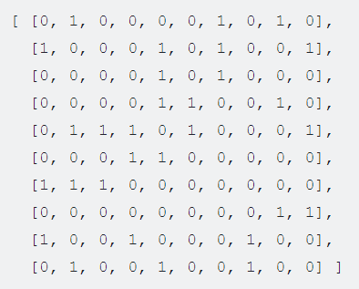
Can be represented programmatically by
ALGORITHMS AND COMPLEXITY
Course Code: ALGOCOM

Slide 33
Adjacency List
An adjacency list is a collection of unordered lists used to represent a finite graph. Each list describes the set of neighbors of a vertex in the graph.
For each vertex v, store an array of the vertices adjacent to it. We typically have an array of |V| adjacency lists, one adjacency list per vertex.
Note: Vertex numbers in an adjacency list are not required to appear in any particular order, though it is often convenient to list them in increasing order, as in this example.
ALGORITHMS AND COMPLEXITY
Course Code: ALGOCOM

Slide 34
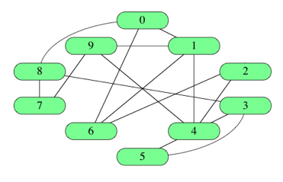
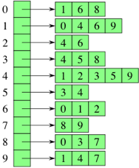
Adjacency List
ALGORITHMS AND COMPLEXITY
Course Code: ALGOCOM

Slide 35
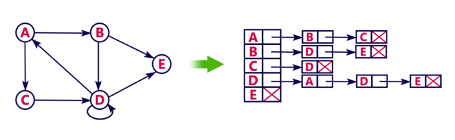
Adjacency List
ALGORITHMS AND COMPLEXITY
Course Code: ALGOCOM

Slide 36
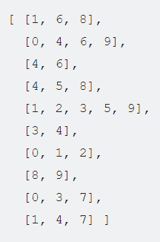
Can be represented programmatically by
ALGORITHMS AND COMPLEXITY
Course Code: ALGOCOM

Slide 37
Activity
1. Create two separate programs that will convert a user-input graph to:
An adjacency matrix representation and
An adjacency list representation
2. Create a program that will transpose a user-input directed graph. Display the original and transposed adjacency matrix as output.
Program requirements: Use OOP concepts, proper documentation of significant parts of the code, readable variables.
Submit to Teams with the following files: .java files, 1 screenshot of output per activity.
ALGORITHMS AND COMPLEXITY
Course Code: ALGOCOM

Slide 38
Graph Search Algorithms
Graph search or traversal refers to the process of visiting or checking each vertex in a graph.
Many graph applications need to visit the vertices of a graph in some specific order based on the graph’s topology. This is known as a graph traversal and is similar in concept to a tree traversal.
ALGORITHMS AND COMPLEXITY
Course Code: ALGOCOM

Slide 39
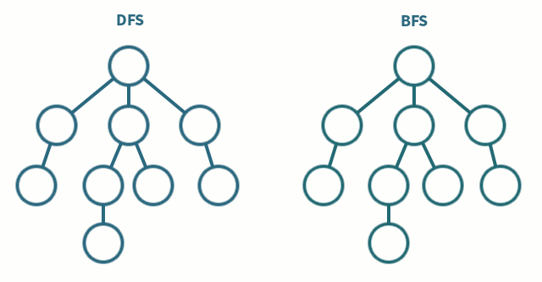
Trees are also graphs
ALGORITHMS AND COMPLEXITY
Course Code: ALGOCOM

Slide 40
Breadth First Search
Breadth-first search (BFS) is an algo­rithm for tra­vers­ing or search­ing tree or graph data struc­tures. It starts at the tree root and explores the adjacent neigh­bor nodes first, before mov­ing to the next level neigh­bors.
Approach:
Pick a node and enqueue all its adjacent nodes into a queue.
Dequeue a node from the queue, mark it as visited and enqueue all its adjacent nodes into a queue.
Repeat this process until the queue is empty or you meet a goal.
ALGORITHMS AND COMPLEXITY
Course Code: ALGOCOM

Slide 41
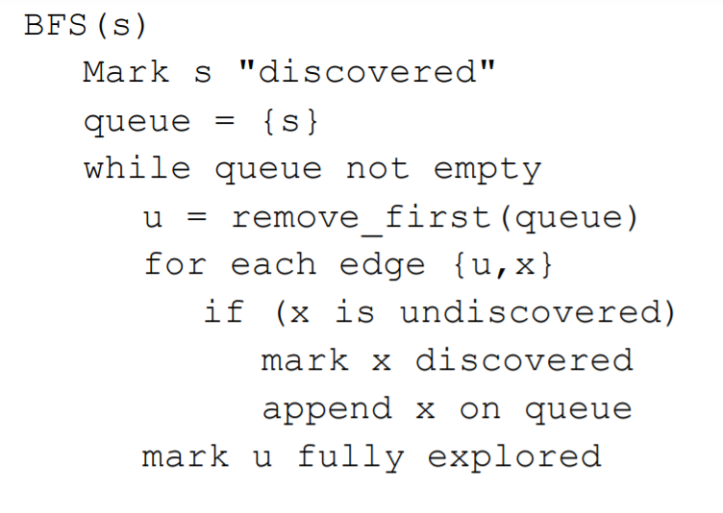
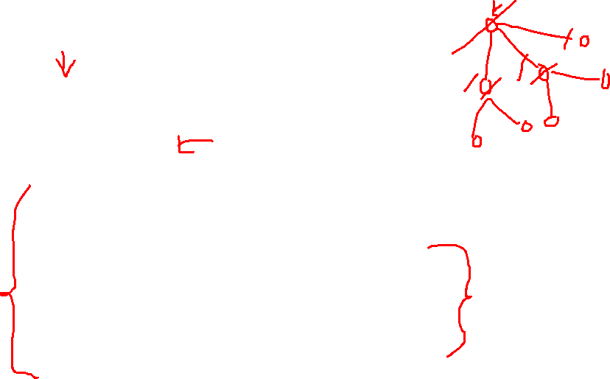
BFS Pseudocode
ALGORITHMS AND COMPLEXITY
Course Code: ALGOCOM

Slide 42
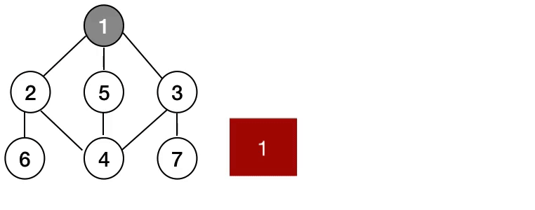
Breadth First Search
ALGORITHMS AND COMPLEXITY
Course Code: ALGOCOM

Slide 43
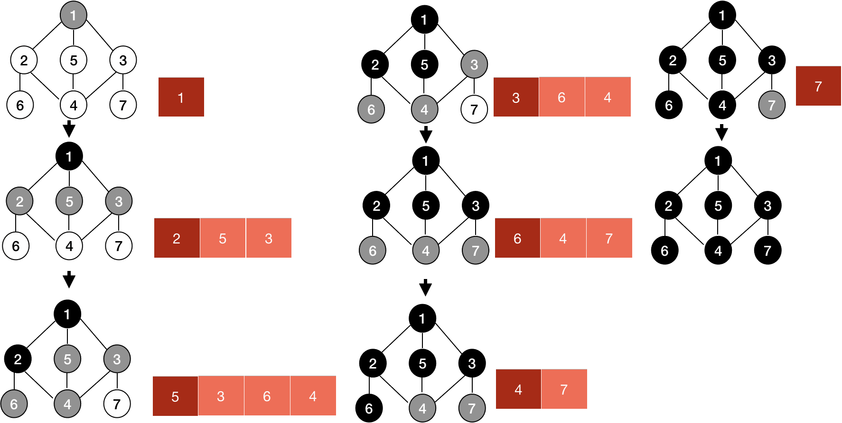
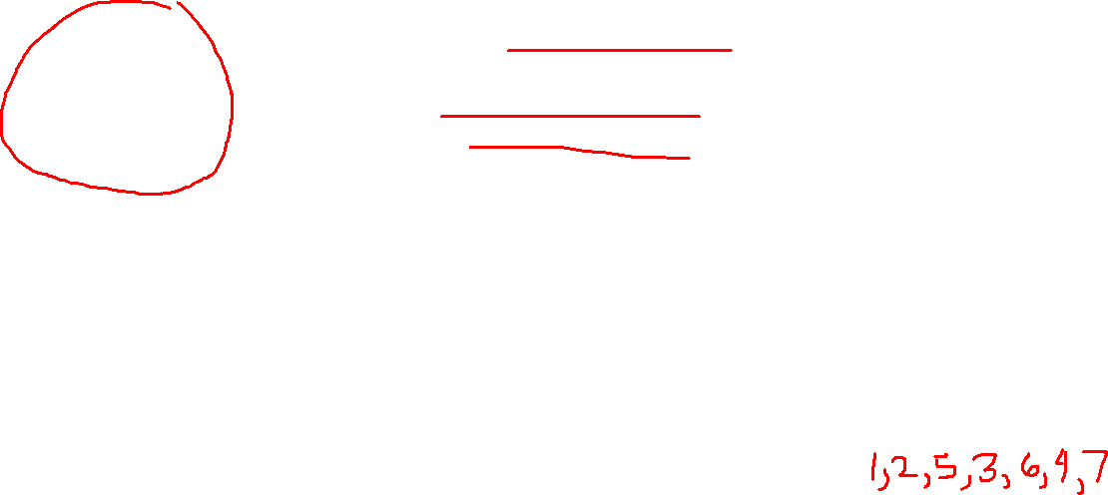
Breadth First Search
ALGORITHMS AND COMPLEXITY
Course Code: ALGOCOM

Slide 44
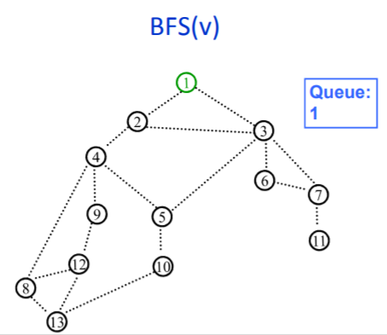
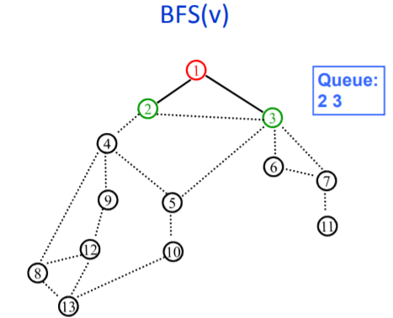
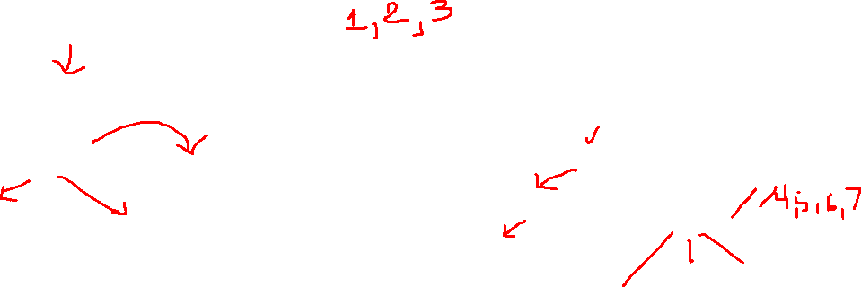
ALGORITHMS AND COMPLEXITY
Course Code: ALGOCOM

Slide 45
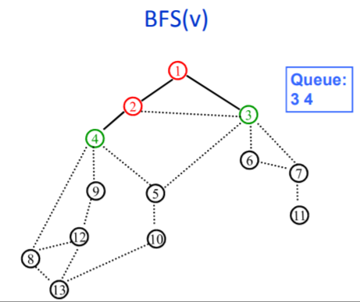
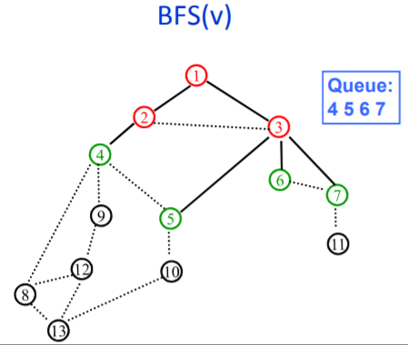
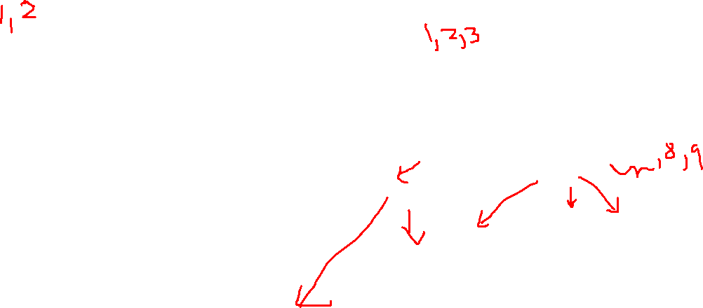
ALGORITHMS AND COMPLEXITY
Course Code: ALGOCOM

Slide 46
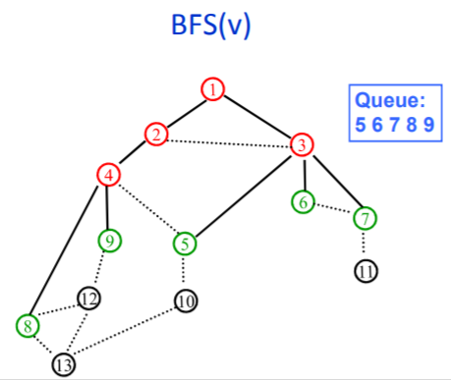
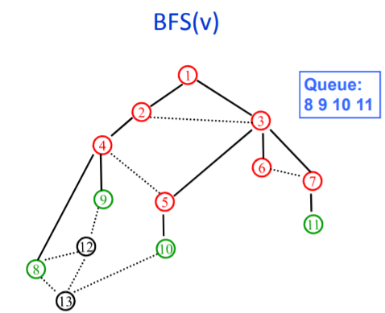
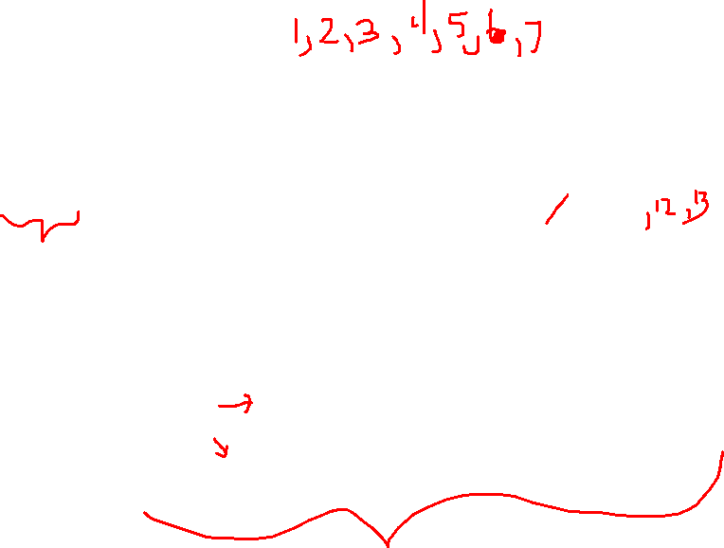
ALGORITHMS AND COMPLEXITY
Course Code: ALGOCOM

Slide 47
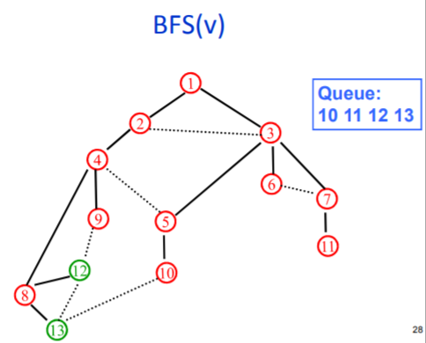
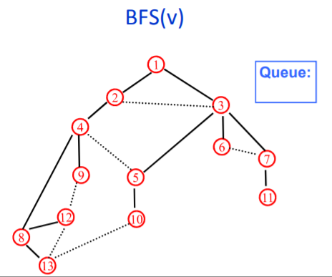

ALGORITHMS AND COMPLEXITY
Course Code: ALGOCOM

Slide 48


Perform BFS
ALGORITHMS AND COMPLEXITY
Course Code: ALGOCOM

Slide 49


Perform BFS
ALGORITHMS AND COMPLEXITY
Course Code: ALGOCOM

Slide 50

BFS Running Time
If we represent the graph G by adjacency matrix then the running time of BFS algorithm is $O(n2)$, where $n$ is the number of nodes.
If we represent the graph G by link lists then the running time of BFS algorithm is $O(m + n)$, where $m$ is the number of edges and $n$ is the number of nodes.
ALGORITHMS AND COMPLEXITY
Course Code: ALGOCOM

Slide 51
Depth First Search
Depth first search (DFS) is another graph traversal algorithm. This algorithm operates by finding a path between two vertices by exploring each possible path as far as possible before backtracking. Often implemented recursively.
Approach:
Pick a node and push all its adjacent nodes into a stack.
Pop a node from the stack and push all its adjacent nodes into a stack.
Repeat this process until the stack is empty or you meet a goal.
ALGORITHMS AND COMPLEXITY
Course Code: ALGOCOM

Slide 52


DFS Pseudocode
ALGORITHMS AND COMPLEXITY
Course Code: ALGOCOM

Slide 53


Depth First Search
ALGORITHMS AND COMPLEXITY
Course Code: ALGOCOM

Slide 54


Depth First Search
ALGORITHMS AND COMPLEXITY
Course Code: ALGOCOM

Slide 55


Depth First Search
ALGORITHMS AND COMPLEXITY
Course Code: ALGOCOM

Slide 56


Perform DFS
ALGORITHMS AND COMPLEXITY
Course Code: ALGOCOM

Slide 57


Perform DFS
ALGORITHMS AND COMPLEXITY
Course Code: ALGOCOM

Slide 58
DFS Running Time
If we represent the graph G by adjacency matrix then the running time of DFS algorithm is $O(n2)$,where $n$ is the number of nodes.
If we represent the graph G by link lists then the running time of DFS algorithm is $O(m + n)$, where $m$ is the number of edges and $n$ is the number of nodes.
ALGORITHMS AND COMPLEXITY
Course Code: ALGOCOM

Slide 59

Solve using BFS and DFS
ALGORITHMS AND COMPLEXITY
Course Code: ALGOCOM

Slide 60



Solution
ALGORITHMS AND COMPLEXITY
Course Code: ALGOCOM

Slide 61
Comparison
BFS uses queue, DFS uses stack.
DFS uses less memory than BFS, easier to reconstruct the path once found.
BFS can be used to find the shortest path. Not always in the case of DFS.
DFS is often used for identifying if the graph is (a)cyclic.
Traversal algorithms will be able to visit all nodes if disconnected.
ALGORITHMS AND COMPLEXITY
Course Code: ALGOCOM

Slide 62
Travelling Salesman problem
Traveling salesman problem, an optimization problem in graph theory in which the nodes (cities) of a graph are connected by directed edges (routes), where the weight of an edge indicates the distance between two cities.
The problem is to find a path that visits each city once, returns to the starting city, and minimizes the distance traveled. The only known general solution algorithm that guarantees the shortest path requires a solution time that grows exponentially with the problem size (i.e., the number of cities).
This is an example of an NP-complete problem (from nonpolynomial), for which no known efficient (i.e., polynomial time) algorithm exists.
ALGORITHMS AND COMPLEXITY
Course Code: ALGOCOM

Slide 63

Travelling Salesman problem
This is an example of an NP-complete problem (from nonpolynomial), for which no known efficient (i.e., polynomial time) algorithm exists.
ALGORITHMS AND COMPLEXITY
Course Code: ALGOCOM

Slide 64

Travelling Salesman problem
ALGORITHMS AND COMPLEXITY
Course Code: ALGOCOM

Slide 65
References:
https://www.freecodecamp.org/news/a-gentle-introduction-to-data-structures-how-graphs-work-a223d9ef8837/
https://www.javatpoint.com/ds-graph
http://www.hamilton.ie/ollie/Downloads/Graph.pdf
http://math.tut.fi/~ruohonen/GT_English.pdf
https://www.tutorialride.com/data-structures/graphs-in-data-structure.htm
https://www.khanacademy.org/computing/computer-science/algorithms/graph-representation/a/representing-graphs
ALGORITHMS AND COMPLEXITY
Course Code: ALGOCOM

